Slide 1

Predicting Rainfall with Machine Learning
Presented by Jainam Shah and Dylan D’Andrea

Slide 2

Contents
Introduction
About Dataset
Goal
EDA
Data Preprocessing
Feature Engineering
Building Machine Learning Model
Results
Future Work
Conclusion

Slide 3
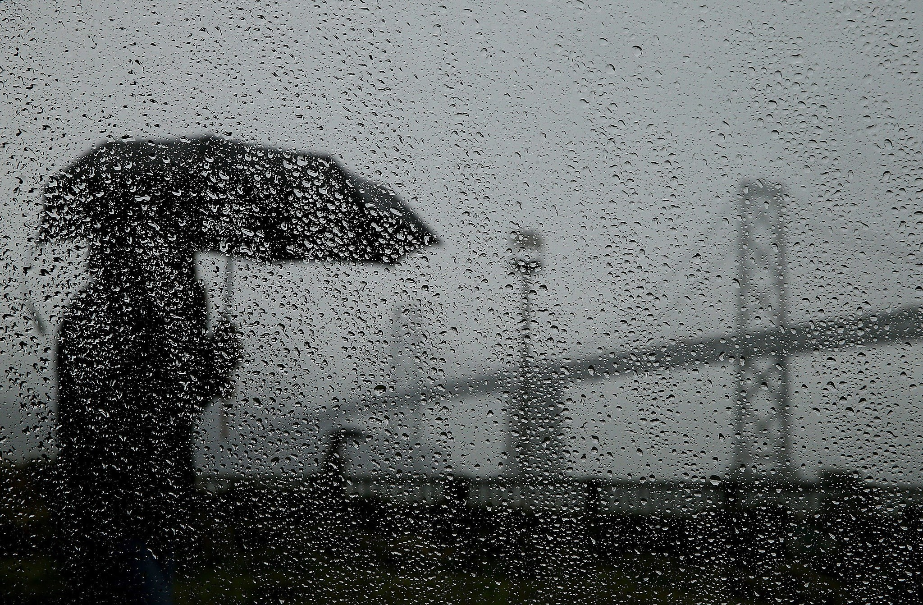
Introduction
Weather forecasts play a crucial role in agriculture, helping farmers make informed decisions on planning, cost-saving, and maximizing crop yield.
Weather prediction involves several factors and predicting weather is possible but complete accuracy is not guaranteed.
The accuracy of prediction can depend on various factors such as quality and quantity of historical data as well as the complexity of weather patterns in any given region.
Localized analysis is necessary to make more precise predictions for specific farms and fields. Overall, with proper data and tools, it is possible to forecast upcoming weather conditions .

Slide 4

About Dataset
The weather dataset is separated into training and testing categories which are then spread over multiple data files based on different regions. This dataset contains a total of 10 features with 566 rows. The features included in the dataset are as under:
Date
Average Temperature
Maximum Temperature
Minimum Temperature
Precipitation
Average wind speed
Maximum wind speed
Maximum wind speed direction
Maximum instant wind speed
Maximum instant wind speed direction
Minimum atmospheric pressure

Slide 5

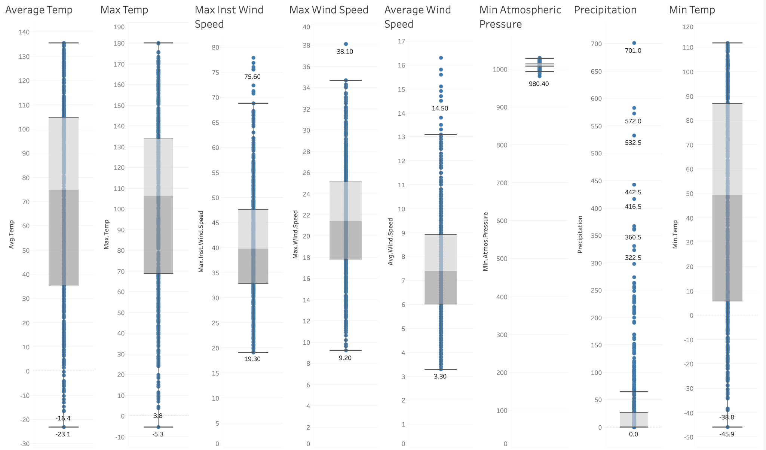
Visualizations and Noteworthy Findings

Slide 6
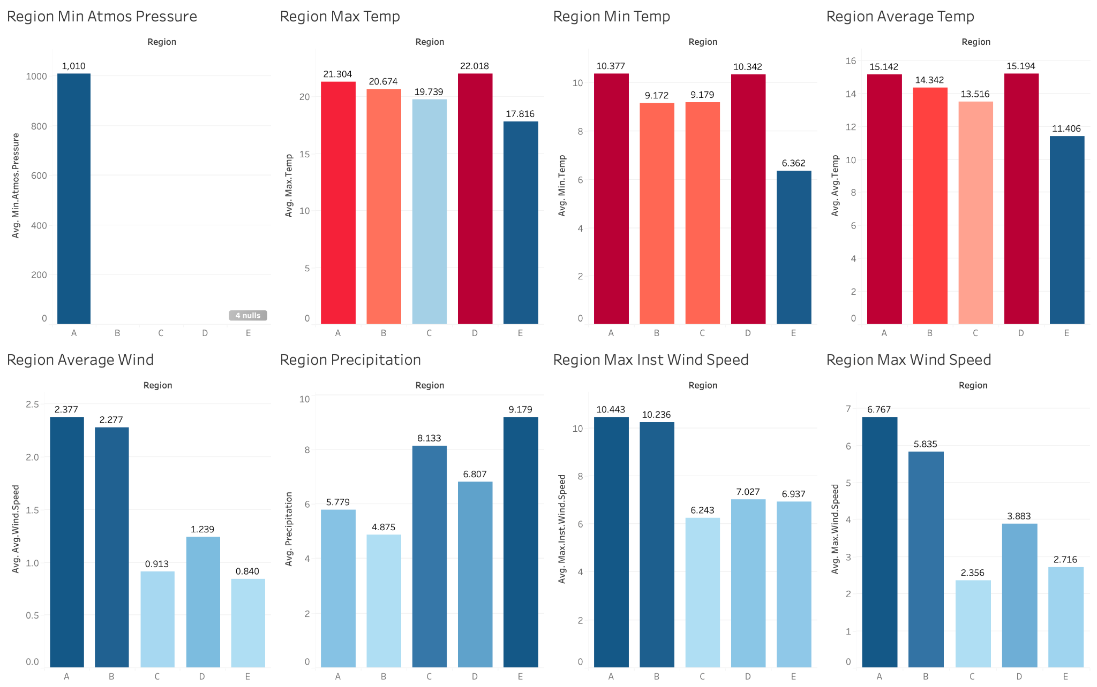
Additional Visualization

Slide 7

GOAL
To predict weather based on three labels:
N - No Rain
L - Light Rain
H- Heavy Rain
Recognize the features affecting the weather.

Slide 8

Data Preprocessing
The steps for Data preprocessing were taken as follows:
Concatenated the segregated data files of training dataset based on regions.
Created a missing values function to find missing values in each feature and segregate it.
Plotted distribution of each feature.
Based on distribution mean values of features were imputed.

Slide 9

Feature Engineering
Following steps were taken to perform feature engineering and train data:
Merged Labels data file with the main training data based on date feature.
Converted categorical variables into numerical using LabelEncoder()
Pivoted data and gave each feature name based on region.(eg: avg_temp_A)
Created a new feature called “Beaufort Scale” to apply on training and testing datasets.

Slide 10

Building Machine Learning Model
For building Machine Learning Model following algorithms and techniques were applied :
LightGBM - Gradient Boosting Framework
Random Forest Classification
Optuna Stacking
XGBoosting

Slide 11

Algorithm #1 LightGBM
LightGBM is an open-source gradient boosting framework that is designed to be efficient, scalable, and high-performance.The following steps were taken to build the model using LightGBM:-
Data types were converted into categorical.
Target class was dropped and training data was split using train_test_split() function (75%:25%)
Data was fitted using LGBMClassifier and evaluated using predict() function.
Confusion matrix was plotted to know occurrence of data and evaluating model performance.
Classification report was implemented to analyze overall model results.
Accuracy achieved on test data - 84.5%

Slide 12
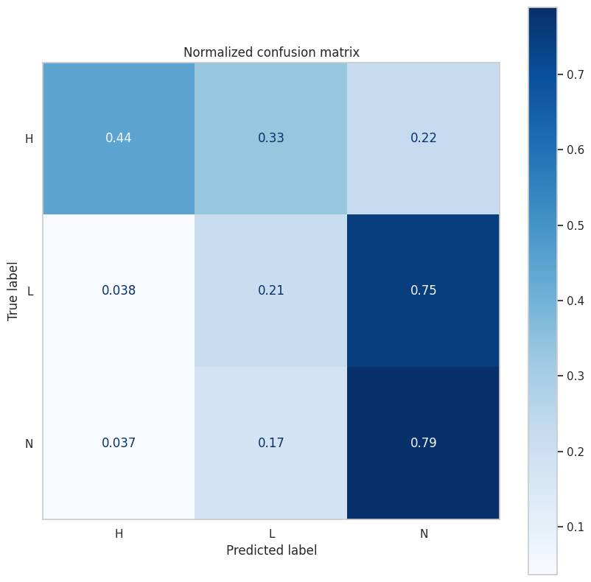
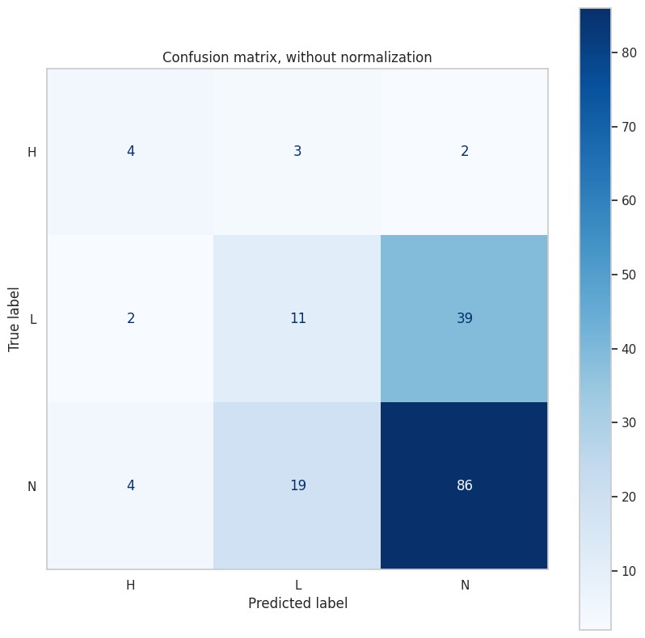
Normalized vs Non Normalized Confusion Matrix

Slide 13
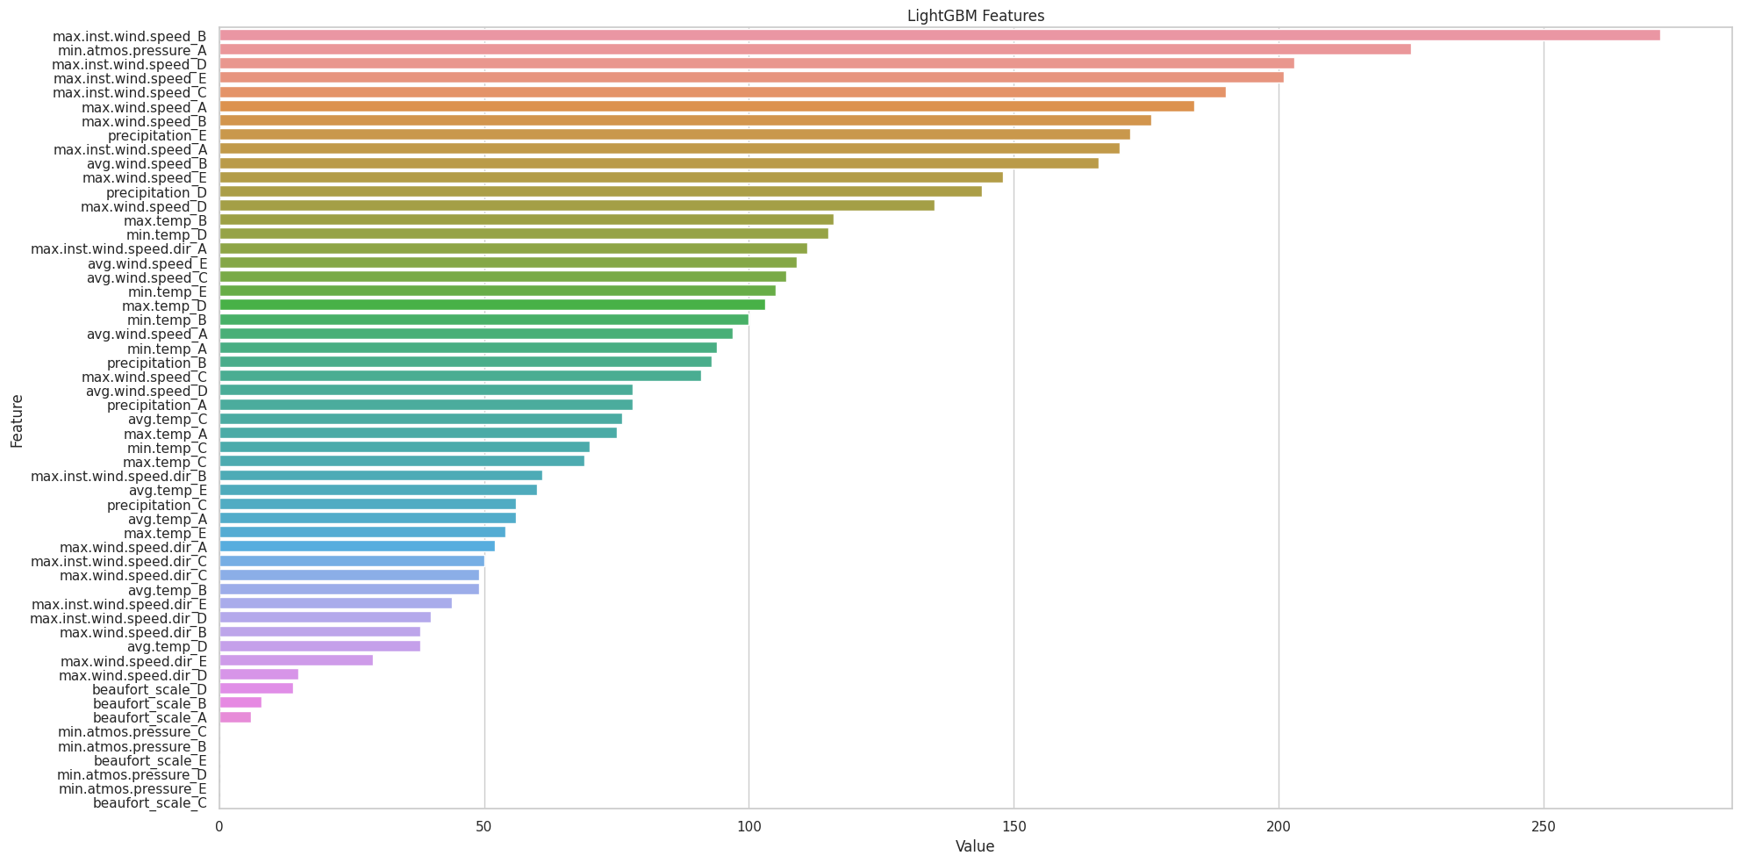
Feature Importance

Slide 14

Algorithm #2 - Random Forest Classification
Random Forest Classification is a type of machine learning algorithm that uses an ensemble of decision trees to classify data. The following steps were taken to build the model using Random Forest Classification:-
Used RFE function with Random Forest Classifier to select and fit features within the training data.
Performed oversampling to deal with imbalance data using RandomOverSampler() function
Standardized data using StandardScaler()
Splitted data using train_test_split() function to fit using RandomForestClassifer() again and tested for accuracy.
Accuracy obtained on testing data - 89.02%

Slide 15

Algorithm #3 Optuna Stacking
Optuna stacking is a hyperparameter optimization technique for ensemble models, specifically stacking or stacked generalization. The following steps were taken to build the model using Optuna Stacking:-
Objective function is defined using a single parameter which takes into account search space for each hyperparameter.
The hyperparameters used are:- criterion,bootstrap,max_depth,max_features,max_leaf_nodes, n_estimators and random state.
A random forest classifier is then instantiated using these hyperparameters by passing them to the RandomForestClassifier constructor.
The cross_val_score function is then used to compute the accuracy.
This function is then passed through optimize() function of optuna stacking to obtain final accuracy.
Accuracy obtained on testing data - 92.48%

Slide 16

Algorithm #4 XGBOOST
Gradient boosting is an ensemble learning technique that combines multiple weak models (decision trees in the case of XGBoost) to create a single strong model. The following steps were taken to build the model using XGBoosting.
Used RFE function with Random Forest Classifier to select and fit features within the training data.
Performed oversampling to deal with imbalance data using RandomOverSampler() function
Standardized data using StandardScaler()
Scaled data was passed through XGBClassifier and fitted using score() function.
Accuracy - 89.67%

Slide 17

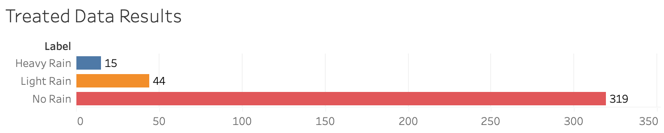
RESULTS
We can predict rainfall with machine learning and with our final result, we can observe that most days will have no rain

Slide 18

FUTURE WORK
There is always availability to test the data with more precision and approaching from a different perspective to get more accurate predictions. So, the base model won’t be enough to make a good prediction; here are some additional steps to improve upon the given approach.
More feature preprocessing and engineering
Use cross-validation to have a better measure of the performance.
Tune class_weight parameter of LightGBM directly to handle imbalance classes.
Balance the dataset by utilizing undersampling or resampling
Test out other algorithms like KNN, SVM, CatBoost etc...

Slide 19
Conclusion
In conclusion, predicting rain with the help of machine learning is an extensive process that can benefit the likes of the agriculture industry which is heavily reliant on weather conditions, thus as is our food supply.
However, data for weather prediction can sometimes be vague and might require a lot of preprocessing to ensure it is a good fit for building a predictive model.
The techniques used in building the machine learning model including LightGBM, Random Forest Classification, Optuna Stacking and XGBoosting provide comprehensive results and on testing does provide positive results on predicting rain through machine learning.

Slide 20

Thank you!
Any Questions?

